Slide 1
Color Memory
a card based puzzle game

Slide 2
Goals & Targets
Given the strict timeline, we had to come up with a set of goals which we wish to achieve through this project.
Some points bla bla
More blabber.. list out the points and explain how our main aim is to focus on UI/UX. A simple game focusing on great design features and crisp & intuitive animations for great user experience.

Slide 3
Feature List: Design
Colour Palette:
The colour palette is inspired from Base16: Ocean. We plan to make both light and dark versions of the interface using the same palette.
Smooth card flip animations.
Fluid gameplay and intuitive gestures.
Mobile first design, bla bla bla..

Slide 4
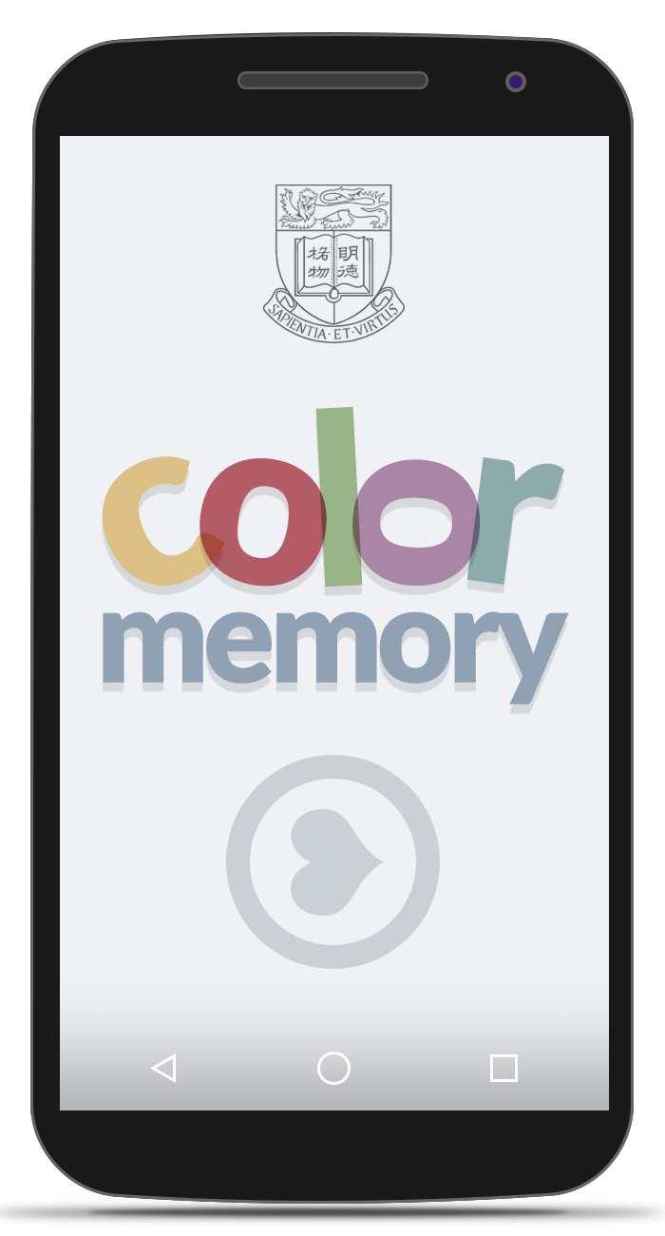
Concept Mockup
This is the first pass on the app’s design and aesthetics. Some pointers about the design process:
In accordance to the brief, we have decided to incorporate the HKU logo on the starting page itself. The logo has been redrawn for this purpose with a wireframe look to fit the minimalism we strive for.
The app logo has been designed to make it both inviting with the use of colours, as well as interesting by introducing asymmetry.

Slide 5
Feature List: Gameplay
Some features
Some points bla bla
Game mechanics/levels etc..

Slide 6
Technical Specifications
Specs:
Platform:
Tools:
Deploy Targets:
Build API, and potential reach, etc etc..

Slide 7
Potential Pitfalls
List some issues that may occur
Some challenges
With design
Or with code
Or something else..

Slide 8
Timeline
Intended work schedule goes here
Random text
Random text
Random text
Random text

Slide 9
Responsibilities
Rahul
Minimalist Designer
Rebellious Programmer
Documentation Ninja
Janssen
Resident Design Expert
Programming Guru
Documentation Destroyer
We have an unusually creative process of dividing responsibilities, and we are not sure whether it’s quantifiable.

Slide 10
Thank you
members:
Janssen Marwin Go 3035150696
Rahul Kumar Thakur 2013854618

